Slide 1
Dynamic Method Dispatch
Also known as Runtime Polymorphism in Java.
It allows a method to be overridden in the subclass and called through a superclass reference.
The method that gets called is determined at runtime, not compile-time.
Key Concepts
Method Overriding: A subclass provides a specific implementation of a method that is already defined in its superclass.
Upcasting: A subclass object is referenced by a superclass reference variable.
Dynamic Binding: Java determines the method to execute at runtime.

Slide 2
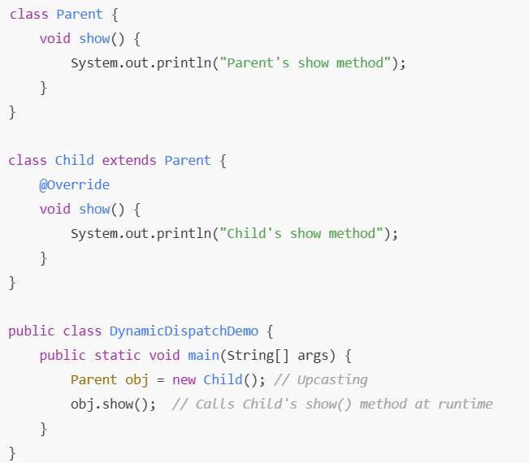
Reference Type Determines Accessible Members:
  Only methods defined in the reference type can be accessed.
Object Type Determines Execution:
  The overridden method in the subclass is executed even when called via the superclass reference.
Why Use Dynamic Method Dispatch?
Encapsulation & Flexibility: Allows calling methods without knowing the exact object type at compile-time.
Code Reusability: Reduces code duplication by enabling common behaviors in the superclass.
Extensibility: New subclasses can override methods without modifying existing code.

Slide 3
class Animal {
void sound() {
System.out.println("Animal makes a sound");
}
}
class Dog extends Animal {
@Override
void sound() {
System.out.println("Dog barks");
}
}
class Cat extends Animal {
@Override
void sound() {
System.out.println("Cat meows");
}
}
public class TestPolymorphism {
public static void main(String[] args) {
Animal a;
a = new Dog();
a.sound(); // Calls Dog's sound method
a = new Cat();
a.sound(); // Calls Cat's sound method
}
}
Rules for Dynamic Method Dispatch
Method must be overridden in the subclass.
The method signature must match the overridden method.
The call must be done via a superclass reference.
Static, final, and private methods cannot be overridden.

Slide 4
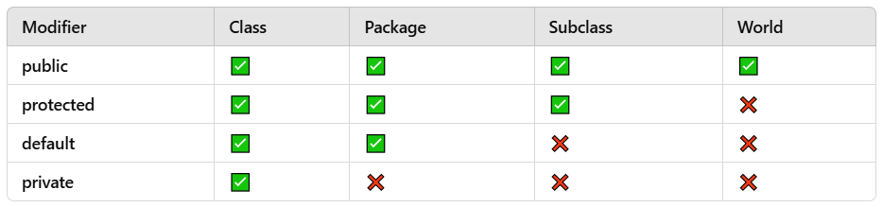
Built-in Packages in Java
Java provides many built-in packages such as:
  java.util → Collections, Date & Time
  java.io → File handling
  java.net → Networking
  java.sql → Database handling
Java Access Modifiers :

Slide 5
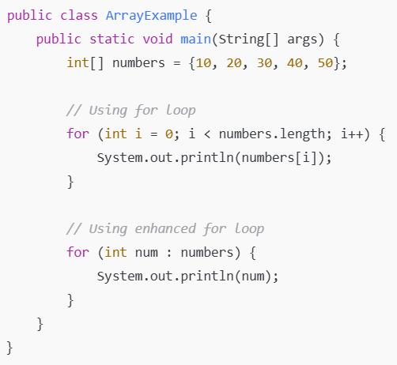
Introduction to Arrays
An array is a fixed-size, indexed collection of elements of the same data type.
Arrays store primitive data types (int, char, etc.) or objects.

Slide 6

Introduction to ArrayList
ArrayList is a resizable dynamic array in Java (part of java.util package).
Advantages over arrays:
Dynamic size (no fixed length)
Built-in methods (add, remove, contains, etc.)

Slide 7
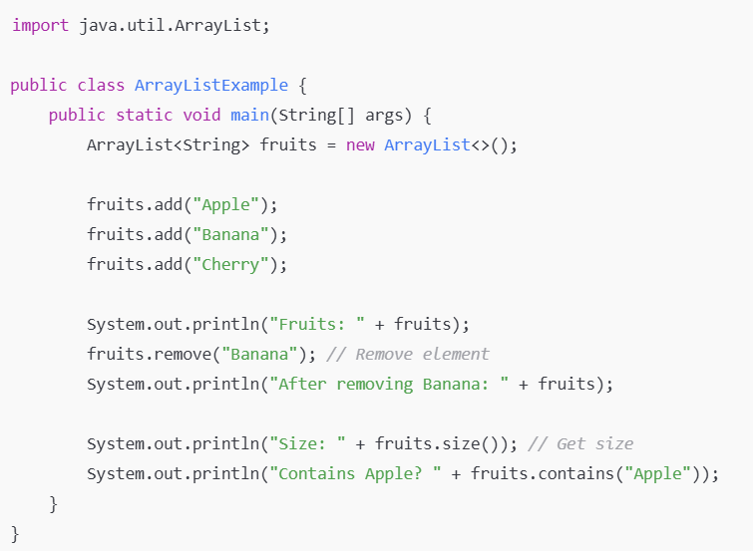

Slide 8
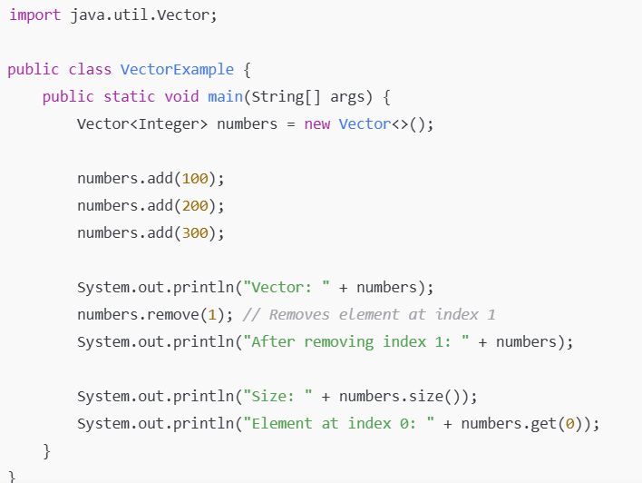

Introduction to Vector
Vector is similar to ArrayList but synchronized (thread-safe).
Slower than ArrayList due to synchronization overhead.

Slide 9
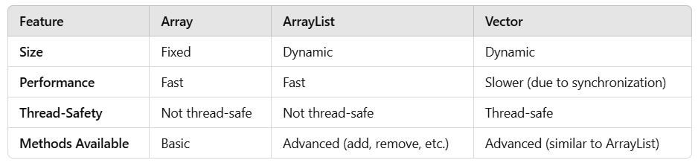

Slide 10
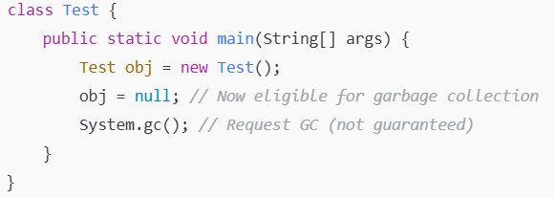
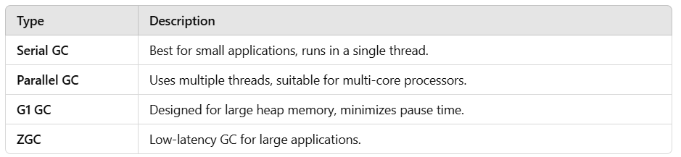
What is Garbage Collection?
Automatic memory management in Java.
Java’s Garbage Collector (GC) removes unused objects from memory.
Prevents memory leaks and improves performance.
How Garbage Collection Works?
Objects are eligible for garbage collection when:
They are no longer reachable.
No active references exist.

Slide 11
Serial GC
The Serial Garbage Collector (Serial GC) in Java is one of the simplest and oldest garbage collection algorithms provided by the JVM. It is designed to work well for applications that have small heaps and run on single-threaded environments.
Key Characteristics of Serial GC:
Single-Threaded:
  The Serial GC uses only one thread to perform garbage collection, which means it does everything serially (one step after the other).
  Both the young generation and old generation are collected using a single thread. This can make the process of garbage collection slower, but it is simple and does not require complex management.
Stop-the-World Event:
  Like other collectors, Serial GC involves a Stop-the-World event, meaning that the application pauses while the garbage collection happens. Since the garbage collection is done serially, the pause can be significant if the heap is large.
  However, for small heaps (e.g., in single-threaded applications or with limited memory), the stop-the-world pauses might not be as noticeable.
Heap Division:
  The heap is still divided into the young generation and the old generation, and the collector will first perform young GC (i.e., collection of newly allocated objects) and then, when necessary, a full GC (i.e., collection of the entire heap, including the old generation).
Simplest Garbage Collection:
  Since it uses a single thread for all GC activities, Serial GC is simple and doesn’t involve complex multi-threading overhead, making it a good choice for applications with low memory requirements and low concurrency needs.
Default for Small Heaps:
  The Serial GC is often the default garbage collector for applications with small heaps, especially when running on machines with limited resources or when performance demands are low.

Slide 12
Partial Garbage Collection (Partial GC):
This term usually refers to a partial or incremental garbage collection that happens in certain types of garbage collection algorithms. In Java, garbage collection typically involves multiple stages, such as collecting the young generation (where newly created objects are allocated) and the old generation (where long-lived objects are moved after surviving multiple GC cycles).
Partial GC usually refers to collecting only certain parts of the heap rather than the whole heap.
It might involve collecting only the young generation, which contains short-lived objects. This is faster because the young generation typically holds many more objects that are short-lived (e.g., local variables or temporary objects) than the old generation.

Slide 13
G1 Garbage Collector (G1 GC):
The G1 GC (Garbage First Garbage Collector) was introduced in JDK 7 and is designed to optimize garbage collection in multi-threaded applications with large heaps. G1 GC is a low-pause, server-style garbage collector and is meant to replace older collectors like CMS (Concurrent Mark-Sweep) and Parallel GC.
Key Features of G1 GC:
Region-based Heap: The heap is divided into regions (which can be of varying sizes) rather than being divided into just the young and old generations. This allows for better memory management and more flexible garbage collection.
Concurrent Collection: G1 performs garbage collection concurrently, meaning that it runs in the background while the application continues to run, which helps minimize pause times.
Predictable Pause Times: G1 allows users to specify a desired maximum pause time, and it tries to meet this target by adjusting the frequency and duration of garbage collection cycles.
Phases of G1 GC:
  Young GC: This collects the young generation (Eden + Survivor spaces).
  Mixed GC: This collects both the young generation and some regions from the old generation.
  Full GC: This is similar to a full garbage collection but is typically triggered less frequently than in older collectors.

Slide 14
Z Garbage Collector (ZGC):
The ZGC (Z Garbage Collector) is a low-latency garbage collector introduced in JEP 333 in JDK 11. It is designed to handle large heaps (multi-terabyte heaps) and minimize the pause times associated with garbage collection. ZGC is especially useful for applications where very low latency is crucial.
Key Features of ZGC:
Concurrent and Low-Latency: ZGC minimizes stop-the-world pause times to sub-millisecond levels, which is useful for applications requiring extremely low-latency operations.
Region-Based: Like G1 GC, ZGC divides the heap into regions, but it performs garbage collection in a way that doesn't cause significant pauses, even for very large heaps.
When to use ZGC:
When low-latency and predictable pause times are critical, such as in real-time systems, databases, or high-frequency trading applications.
ZGC is best suited for applications with large heaps (over 10 GB) and where minimal GC pause time is needed.

Slide 15
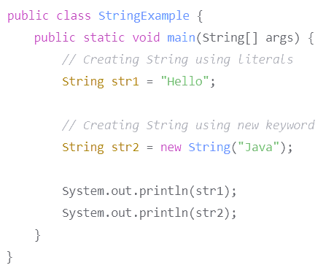
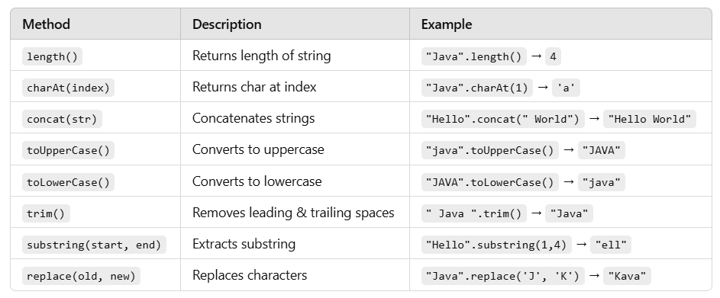
What is a String?
A String in Java is an immutable sequence of characters.
Immutable: Once created, its value cannot be changed.

Slide 16
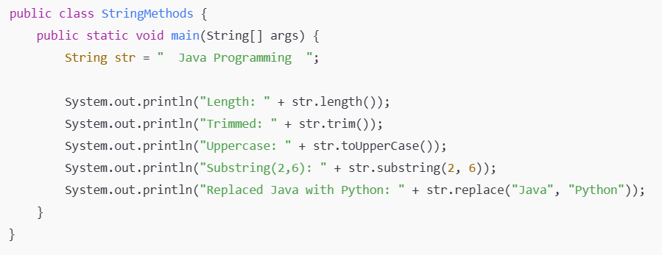

Slide 17
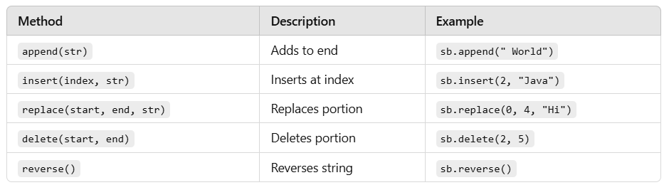
What is StringBuffer?
Mutable (modifiable) version of String.
Used when frequent string modifications are required.
Thread-safe (synchronized).

Slide 18
public class StringBufferExample {
public static void main(String[] args) {
StringBuffer sb = new StringBuffer("Hello");
sb.append(" World");
System.out.println("After Append: " + sb);
sb.insert(6, "Java ");
System.out.println("After Insert: " + sb);
sb.replace(0, 5, "Hi");
System.out.println("After Replace: " + sb);
sb.delete(2, 5);
System.out.println("After Delete: " + sb);
sb.reverse();
System.out.println("After Reverse: " + sb);
}
}

Slide 19
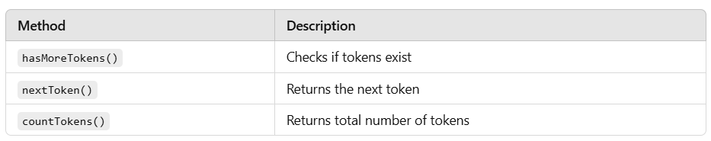
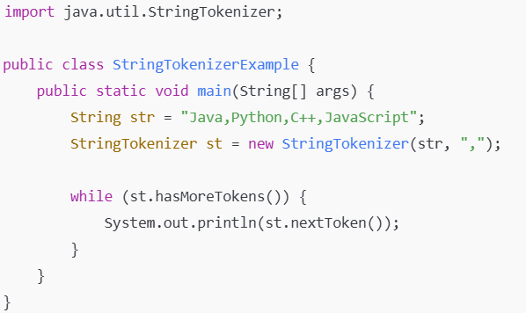
What is StringTokenizer?
Used for splitting a string into tokens (words, numbers, etc.).
Defined in java.util package.
Faster than split() method of String class.

Slide 20
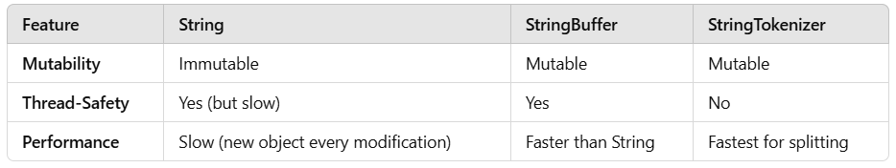

Slide 21
Scenario:
You are tasked with developing a simple Library Management System in Java. The system should allow users to add books, search for books by title, and display all books in the library. Each book has a title, author, and ISBN number.
Requirements:
Create a Book class with the following attributes:
  title (String)
  author (String)
  isbn (String)
Create a Library class that manages a collection of books. The Library class should have the following methods:
  addBook(Book book): Adds a book to the library.
  searchByTitle(String title): Searches for a book by its title and returns the book if found.
  displayAllBooks(): Displays all books in the library.
Create a Main class to test the functionality of the Library class.
Question:
Write the Java code to implement the above scenario. Your code should include the Book class, the Library class, and the Main class. Ensure that the Main class demonstrates adding books, searching for a book by title, and displaying all books.

Slide 22
Scenario:
You are tasked with developing a simple Student Grade Management System in Java. The system should allow users to add students, add grades for each student, calculate the average grade for a student, and display all students along with their grades and average.
Requirements:
Create a Student class with the following attributes:
  name (String)
  grades (List of Double)
The Student class should have the following methods:
  addGrade(double grade): Adds a grade to the student's list of grades.
  calculateAverage(): Calculates and returns the average grade of the student.
  displayStudentDetails(): Displays the student's name, grades, and average.
Create a GradeManager class that manages a collection of students. The GradeManager class should have the following methods:
  addStudent(Student student): Adds a student to the system.
  findStudentByName(String name): Finds and returns a student by their name.
  displayAllStudents(): Displays all students along with their grades and average.
Create a Main class to test the functionality of the GradeManager class.
Question:
Write the Java code to implement the above scenario. Your code should include the Student class, the GradeManager class, and the Main class. Ensure that the Main class demonstrates adding students, adding grades, calculating averages, and displaying all students.

Slide 23
Scenario:
You are tasked with developing a simple Online Shopping Cart System in Java. The system should allow users to add products to a shopping cart, remove products, calculate the total cost of the cart, and display all products in the cart.
Requirements:
Create a Product class with the following attributes:
  name (String)
  price (double)
Create a ShoppingCart class that manages a collection of products. The ShoppingCart class should have the following methods:
  addProduct(Product product): Adds a product to the cart.
  removeProduct(String productName): Removes a product from the cart by its name.
  calculateTotalCost(): Calculates and returns the total cost of all products in the cart.
  displayCart(): Displays all products in the cart along with their prices and the total cost.
Create a Main class to test the functionality of the ShoppingCart class.
Question:
Write the Java code to implement the above scenario. Your code should include the Product class, the ShoppingCart class, and the Main class. Ensure that the Main class demonstrates adding products, removing products, calculating the total cost, and displaying the cart.

Slide 24
Scenario:
You are tasked with developing a Bank Account Management System in Java. The system should allow users to create bank accounts, deposit money, withdraw money, transfer money between accounts, and display account details. Additionally, the system should handle exceptions such as insufficient funds and invalid transactions.
Requirements:
Create an Account class with the following attributes:
  accountNumber (String)
  accountHolderName (String)
  balance (double)
The Account class should have the following methods:
  deposit(double amount): Deposits money into the account.
  withdraw(double amount): Withdraws money from the account (throws an exception if insufficient funds).
  transfer(Account targetAccount, double amount): Transfers money to another account (throws an exception if insufficient funds or invalid account).
  displayAccountDetails(): Displays the account details.
Create a Bank class that manages a collection of accounts. The Bank class should have the following methods:
  createAccount(String accountNumber, String accountHolderName, double initialBalance): Creates a new account and adds it to the bank.
  getAccount(String accountNumber): Finds and returns an account by its account number.
  displayAllAccounts(): Displays all accounts in the bank.
Create a custom exception class InsufficientFundsException to handle insufficient funds scenarios.
Create a Main class to test the functionality of the Bank class.
Question:
Write the Java code to implement the above scenario. Your code should include the Account class, the Bank class, the InsufficientFundsException class, and the Main class. Ensure that the Main class demonstrates creating accounts, depositing, withdrawing, transferring money, and handling exceptions.

Slide 25
Scenario:
You are tasked with developing an Employee Payroll Management System in Java. The system should allow users to manage employees, calculate their monthly salary based on their role, and apply bonuses or deductions. The system should use a switch-case statement to handle different employee roles and their respective salary calculations.
Requirements:
Create an Employee class with the following attributes:
  employeeId (String)
  name (String)
  role (String) – Roles can be "Manager", "Developer", "Designer", or "Intern".
  baseSalary (double)
The Employee class should have the following methods:
  calculateSalary(): Calculates the monthly salary based on the employee's role using a switch-case statement.
    Manager: Base salary + 20% bonus.
    Developer: Base salary + 10% bonus.
    Designer: Base salary + 5% bonus.
    Intern: Fixed salary of $1000 (ignores base salary).
  applyDeduction(double amount): Applies a deduction to the employee's salary.
  displayEmployeeDetails(): Displays the employee's details, including their calculated salary.
Create a Payroll class that manages a collection of employees. The Payroll class should have the following methods:
  addEmployee(Employee employee): Adds an employee to the payroll.
  calculateAllSalaries(): Calculates and displays the salaries of all employees.
  findEmployeeById(String employeeId): Finds and returns an employee by their ID.
Create a Main class to test the functionality of the Payroll class.
Question:
Write the Java code to implement the above scenario. Your code should include the Employee class, the Payroll class, and the Main class. Ensure that the Main class demonstrates adding employees, calculating salaries, applying deductions, and displaying employee details.

Slide 26


Slide 27
